Slide 1
Data Preparation and Analysis Module 6

Slide 2
Binary Logistic Regression
Mr. Ming-Long Lam Ph.D. in Statistics

Slide 3
Module 6 Lesson Plan
Lesson 1: Logistic Regression
Understand the Concept of Odds and Odds Ratio
Formulate and Estimate the Model.
Beware of Complete or Quasi-Complete Separation.
Lesson 2: Forward Selection
Understand the Concept of Nested Models and the Deviance Test.
Use the Forward Selection Method to Build the Model.
Lesson 3: Interpret Model and Assess Performance
Interpret Parameter Estimates.
Use the R-squares to Evaluate the Performance.

Slide 4
END OF INTRODUCTION

Slide 5
Lesson 1: Logistic Regression

Slide 6
An Odd Word

Slide 7
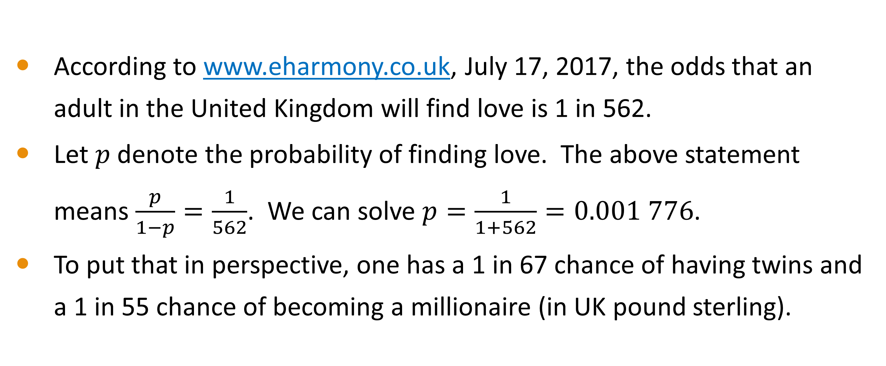
Odds of Love
According to www.eharmony.co.uk, July 17, 2017, the odds that an adult in the United Kingdom will find love is 1 in 562.
Let $p$ denote the probability of finding love. The above statement means $\frac{p}{1−p}=\frac{1}{562}$. We can solve $p=\frac{1}{1+562}=0.001 776$.
To put that in perspective, one has a 1 in 67 chance of having twins and a 1 in 55 chance of becoming a millionaire (in UK pound sterling).

Slide 8
Odds for a Binary Outcome
The odds of an Event is the ratio by dividing the probability of the Event occurring by the probability of the Non-Event occurring
Suppose the probability of the Event occurring is $0≤p≤1$, the Odds are $p/{\left(1−p\right)}$
Suppose the probability of the Event occurring is 0≤𝑝≤1, the Odds are 𝑝∕(1−𝑝)
The Event will never occur, i.e., $p=0$, then Odds = 0
The Event will never occur, i.e., 𝑝=0, then Odds = 0
50/50 Event chance, i.e., $p=\frac{1}{2}$, then Odds = 1.
50/50 Event chance, i.e., 𝑝=1/2, then Odds = 1.
Odds are a number in the interval $\left[0\right.,∞)$
Odds are a number in the interval [0┤,∞)
The Event will surely occur, i.e., $p=1$, then Odds = $∞$
The Event will surely occur, i.e., 𝑝=1, then Odds = ∞

Slide 9
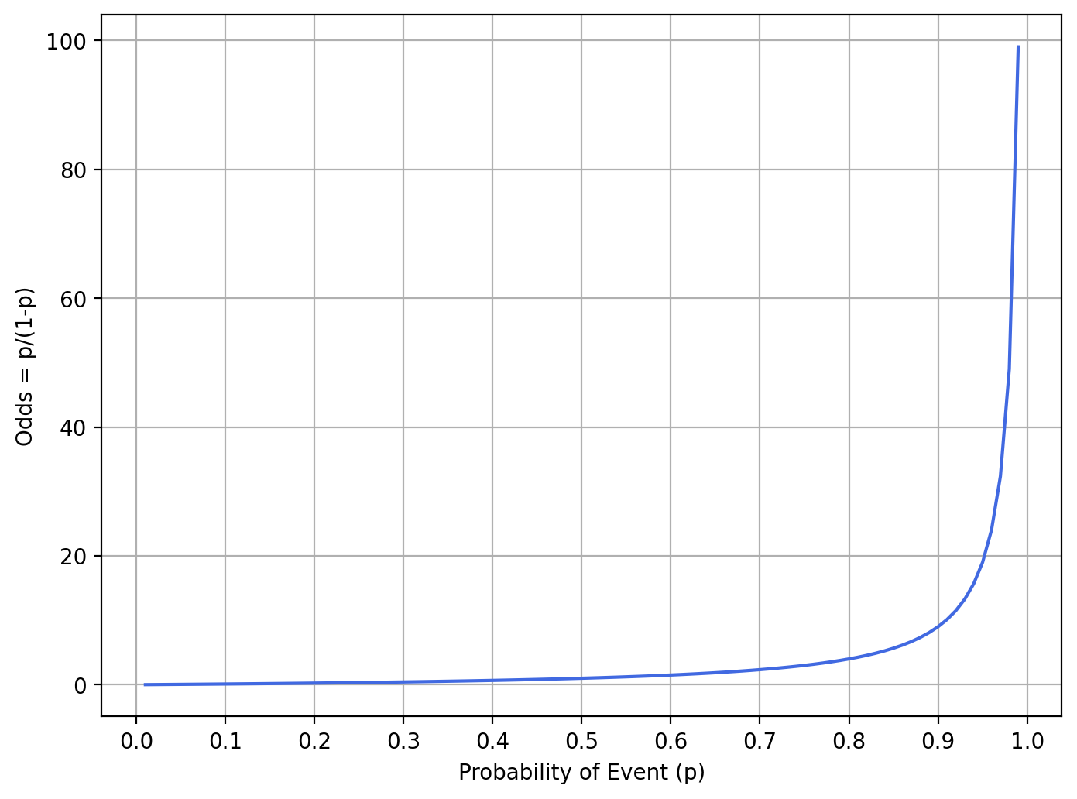
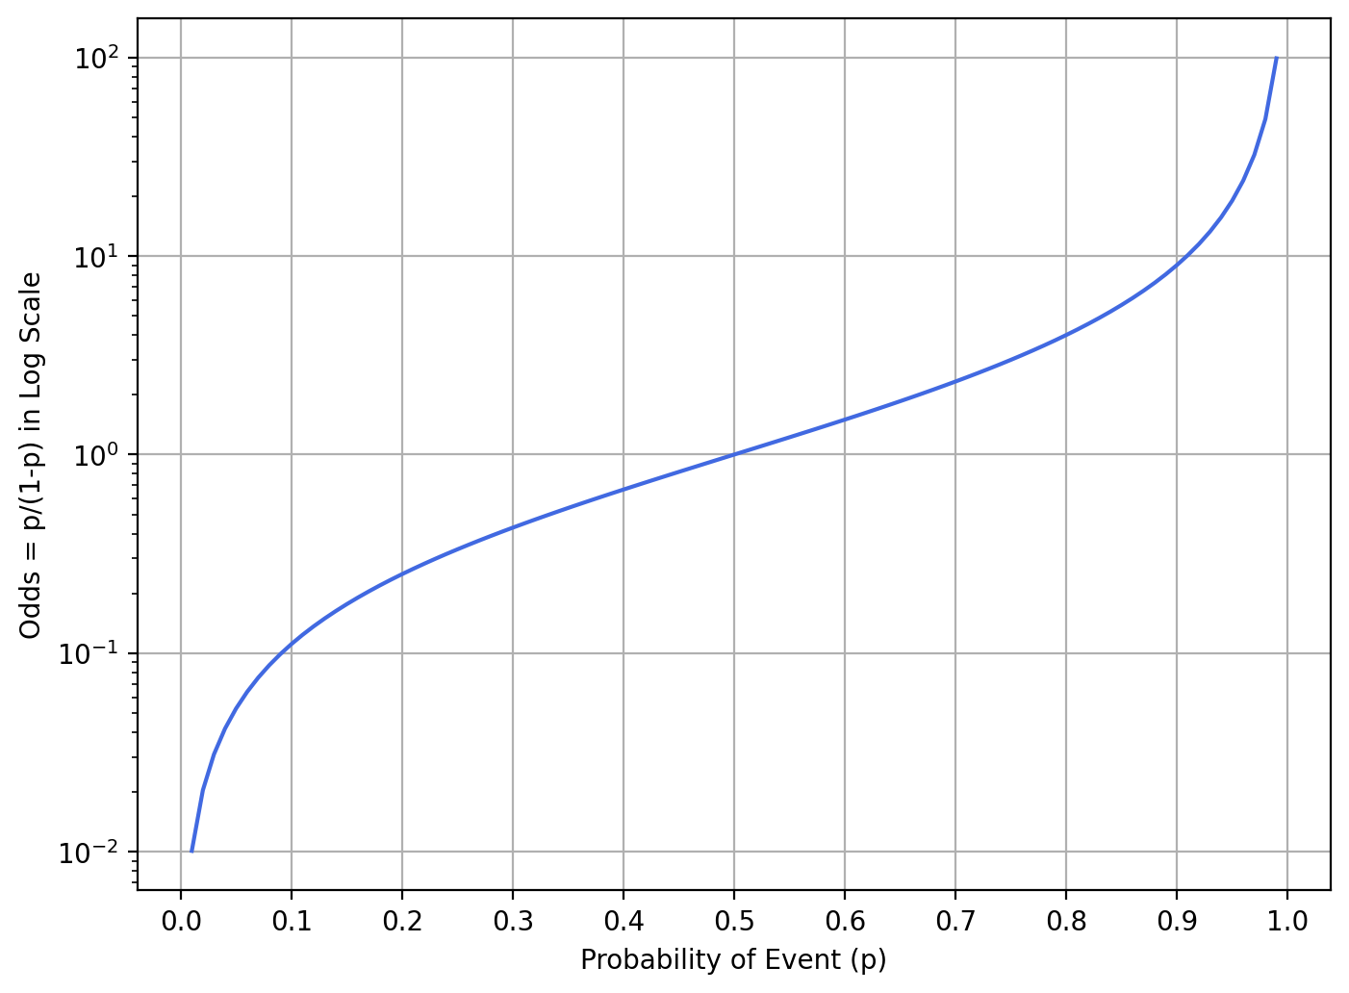
Odds Versus Probability
The log-scale chart on the right suggests that the logarithm of Odds is approximately linear in the probability within a certain range (e.g., between 0.2 and 0.8) of probability.

Slide 10
An Idea For Predicting Probability
Before the era of modern computers, people have been trying to predict probability using a linear regression model. Of course, we are fully aware of the drawbacks of these attempts (e.g., negative predicted probability).
Since the logarithm of odds is approximately linear in the probability within the middle portion (e.g., between 0.2 and 0.8) of the probability scale, we have a new idea! Instead of using the probability as the target variable in a model, we use the logarithm of odds as the target variable.

Slide 11
Logistic Regression For a Binary Response

Slide 12
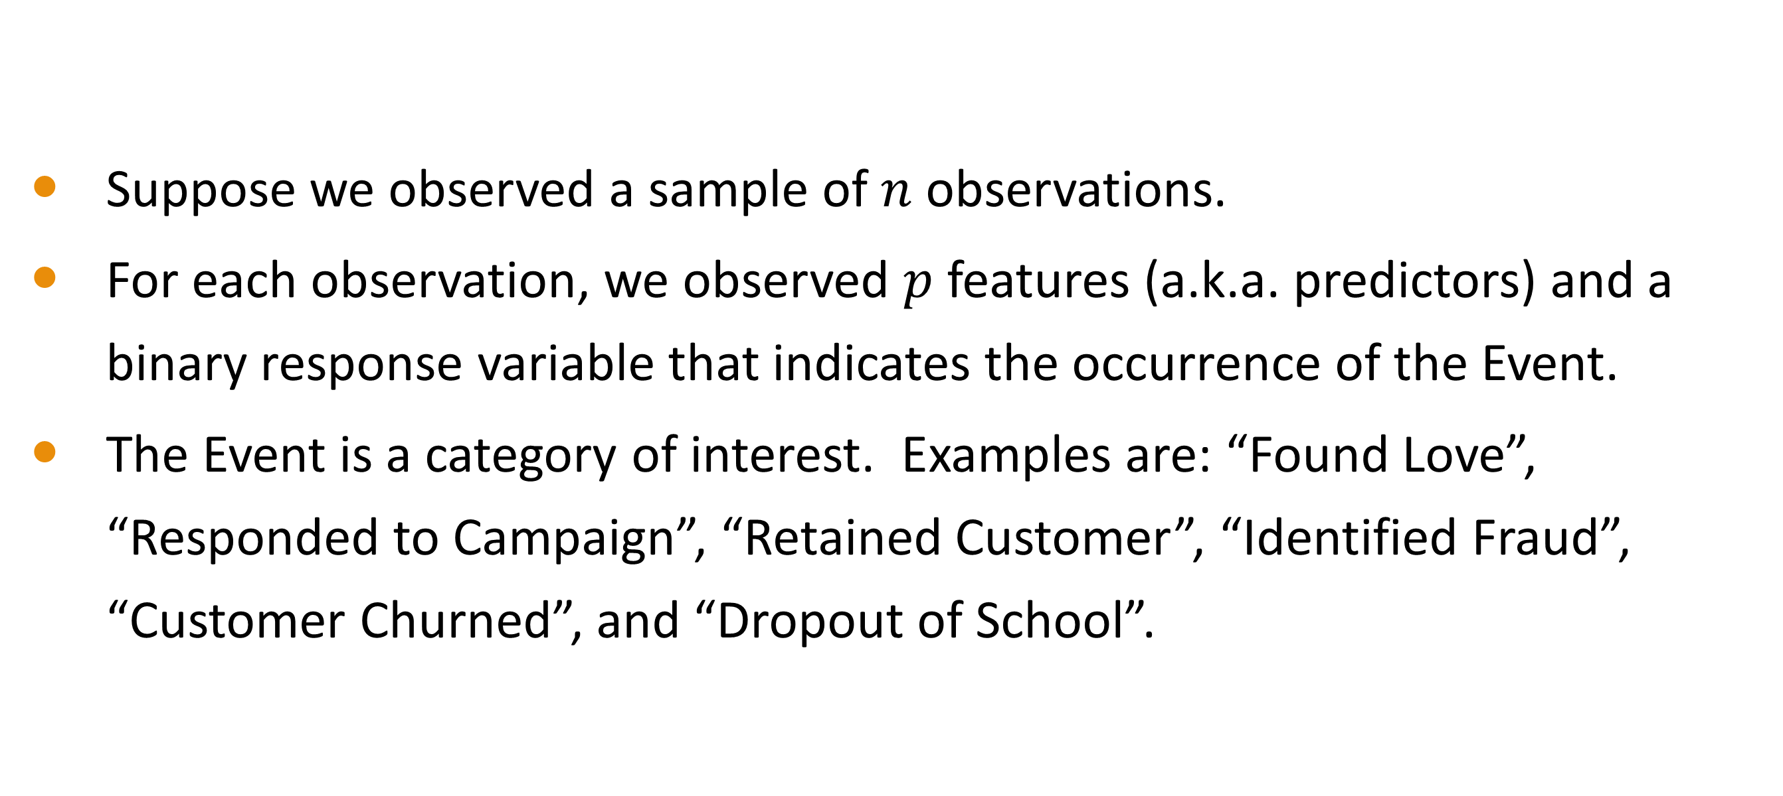
Training Data
Suppose we observed a sample of $n$ observations.
For each observation, we observed $p$ features (a.k.a. predictors) and a binary response variable that indicates the occurrence of the Event.
The Event is a category of interest. Examples are: “Found Love”, “Responded to Campaign”, “Retained Customer”, “Identified Fraud”, “Customer Churned”, and “Dropout of School”.

Slide 13
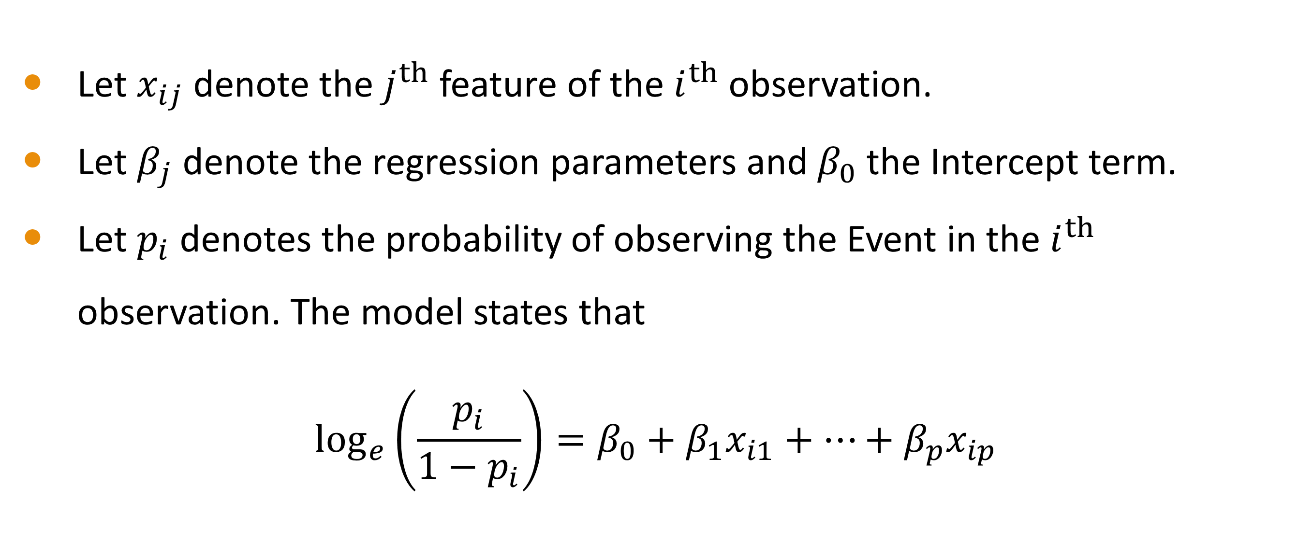
Binary Logistic Regression Model
Let $x_{ij}$denote the $j^{th}$ feature of the $i^{th}$ observation.
Let $β_{j}$denote the regression parameters and $β_{0}$the Intercept term.
Let $p_{i}$ denotes the probability of observing the Event in the $i^{th}$ observation. The model states that
$$\log_{e}\left(\frac{p_{i}}{1−p_{i}}\right)=β_{0}+β_{1}x_{i1}+…+β_{p}x_{ip}$$

Slide 14
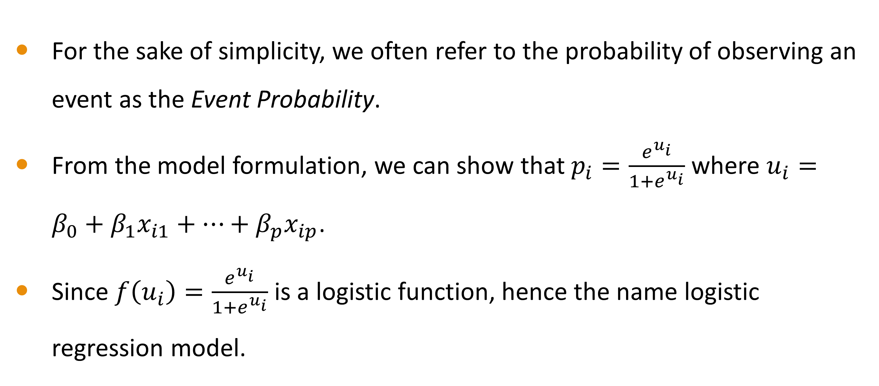
Event Probability
For the sake of simplicity, we often refer to the probability of observing an event as the Event Probability.
From the model formulation, we can show that $p_{i}=\frac{e^{u_{i}}}{1+e^{u_{i}}}$ where $u_{i}=β_{0}+β_{1}x_{i1}+…+β_{p}x_{ip}$.
Since $f\left(u_{i}\right)=\frac{e^{u_{i}}}{1+e^{u_{i}}}$ is a logistic function, hence the name logistic regression model.

Slide 15
Applying Binary Logistic Regression for …
Marketing Campaign
What are the factors that influence a consumer’s purchase behavior?
Insurance Policy Churn
Political Election
What are the demographic features that can drive election results?
What are the attributes in an insurance policy that best predict churn?
How do the factors affect the propensity to purchase?
How can we leverage the features to favor one candidate over another?
What is the customer profile that can maximize policy retention?

Slide 16
=== In-Video Questions For Slide 15 ===
Besides these applications, are you aware of any analysis where the response is a binary label variable?
Suggestions. The vital status (alive or deceased) of a patient after suffering from a heart attack. The employment status (retained or not) of a personal banker three years after hiring.

Slide 17
Maximum Likelihood Method of Estimation

Slide 18
Estimate Regression Parameters
The maximum likelihood method is the industry standard for training a logistic regression model.
This method determines the values of the regression parameters and, in turn, predicts the Event Probability of each observation.
This method finds the optimal values (a.k.a. estimates) via an iterative procedure for the regression parameters such that the Event Probabilities best match the observed odds in the data.

Slide 19
Does The Iterative Procedure Always Converge?
Except for problematic data, the iterative procedure will converge.
A model with many features will, of course, require more iterations to converge than a model with only a few features.
The iterative procedure usually implements the industry standard Newton-Raphson method (or an adaptation of it).
This Newton-Raphson method converges, in theory, at a rate of two. At this rate, we may obtain at most two additional significant digits in the estimates for every iteration.

Slide 20
StatsModels Logistic Classifier
Logit() A binary logistic classifier
MNLogit() A multi-class logistic classifier
StatsModels API Reference

Slide 21
StatsModels Logistic Classifier Usage Notes
The classifier estimates the model by the maximum likelihood method.
We prefer the MNLogit() as it is more accommodating.
For a binary response variable, both the Logit() and the MNLogit() functions will, by default, take the last category as the Event.
The last category associates with the lexically higher value. For instance, the response categories are No and Yes. The last category is Yes.

Slide 22
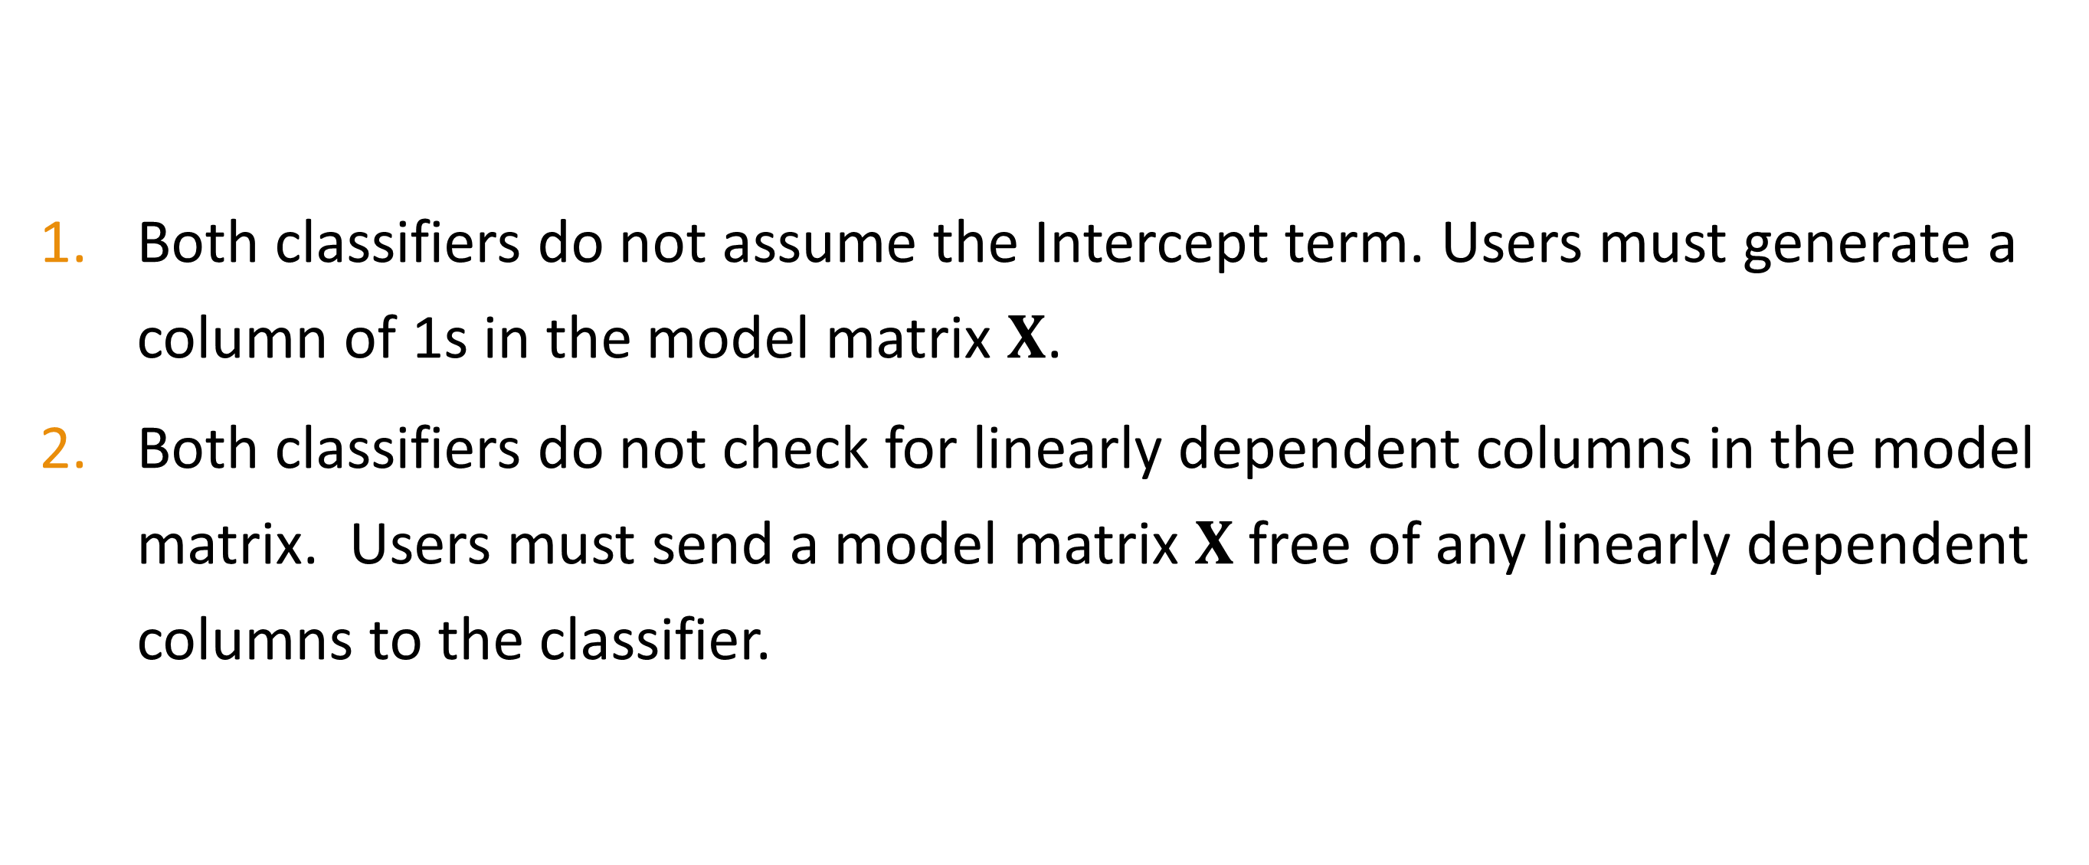
StatsModels Logistic Classifier Usage Notes
Both classifiers do not assume the Intercept term. Users must generate a column of 1s in the model matrix $X$.
Both classifiers do not check for linearly dependent columns in the model matrix. Users must send a model matrix $X$ free of any linearly dependent columns to the classifier.

Slide 23
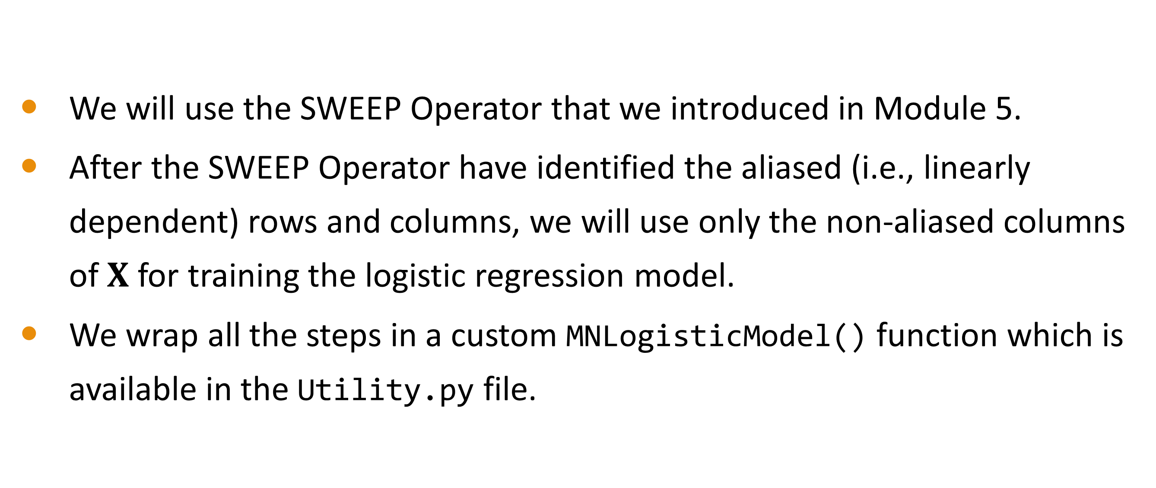
Check for Linearly Dependent Columns
We will use the SWEEP Operator that we introduced in Module 5.
After the SWEEP Operator have identified the aliased (i.e., linearly dependent) rows and columns, we will use only the non-aliased columns of $X$ for training the logistic regression model.
We wrap all the steps in a custom MNLogisticModel() function which is available in the Utility.py file.

Slide 24
The Separation Phenomenon

Slide 25
Do You Notice Something Peculiar?
CaseID | x1 | x2 | y
1 | 0.1 | 0.4 | 0
2 | 0.1 | 0.4 | 0
3 | 0.1 | 0.4 | 0
4 | 0.2 | 0.4 | 0
5 | 0.2 | 0.4 | 0
6 | 0.3 | 0.4 | 0
7 | 0.3 | 0.4 | 0
8 | 0.3 | 0.4 | 0
9 | 0.1 | 0.8 | 0
10 | 0.1 | 0.8 | 0
11 | 0.1 | 0.8 | 0
12 | 0.4 | 0.8 | 1
13 | 0.4 | 0.8 | 1
14 | 0.6 | 0.8 | 1
15 | 0.6 | 0.8 | 1
16 | 0.6 | 0.8 | 1
When x1 = 0.4 or 0.6, y = 1.

Slide 26
=== In-Video Questions For Slide 23 ===
Run the following codes. What results do you get?
import pandas
import statsmodels.api as smodel
X = pandas.DataFrame({'x1': [0.1, 0.1, 0.1, 0.2, 0.2, 0.3, 0.3, 0.3, 0.1, 0.1, 0.1, 0.4, 0.4, 0.6, 0.6, 0.6],
'x2': [0.4, 0.4, 0.4, 0.4, 0.4, 0.4, 0.4, 0.4, 0.8, 0.8, 0.8, 0.8, 0.8, 0.8, 0.8, 0.8]})
y = pandas.DataFrame({'y': [0, 0, 0, 0, 0, 0, 0, 0, 0, 0, 0, 1, 1, 1, 1, 1]})
X.insert(0, 'Intercept', 1.0)
objModel = smodel.Logit(y, X)
print('Name of Response: ', objModel.endog_names)
print('Name of Features: ', objModel.exog_names)
thisFit = objModel.fit()
print(thisFit.summary())
Change the last element of y from 1 to 0, what do you get now?

Slide 27
The Separation Phenomenon
Complete Separation: The predictors completely determine the target category in every observation.
Quasi-Complete Separation: The predictors completely determine the target category in the majority but not all observations.

Slide 28
Common Causes
Used categorical features that have as many unique values as the number of observations. e.g., the Employee ID.
Mistakenly specified a continuous feature as categorical.
Included too many features, but not enough observations. Every observation is a unique value combination of the features.

Slide 29
Technical Signs of Separation
The log-likelihood value is practically zero.
The predicted Event Probabilities are one for the Event observations and zero otherwise.
Some, if not all, of the parameter estimates are big values, either positive or negative. Their standard errors are even bigger.

Slide 30
=== In-Video Questions For Slide 27 ===
Do we dream about having predicted Event Probability to be one for the event observations? So, why do we think separation is not a good thing?
Feedback. Separation is a phenomenon in the training data. We cannot guarantee this to happen for all data. Besides, those very large parameter estimates look seemingly wrong!

Slide 31
Workaround for Separation Phenomenon
Merge categories of low counts and form another category.
Reduce the precision of a continuous feature, e.g., round the values to fewer decimal places.
Consider the pre-binning of a continuous feature and use the resulting bin identifiers as a categorical predictor instead.

Slide 32
END OF LESSON 1

Slide 33
Lesson 2: Forward Selection

Slide 34
Nested Models

Slide 35

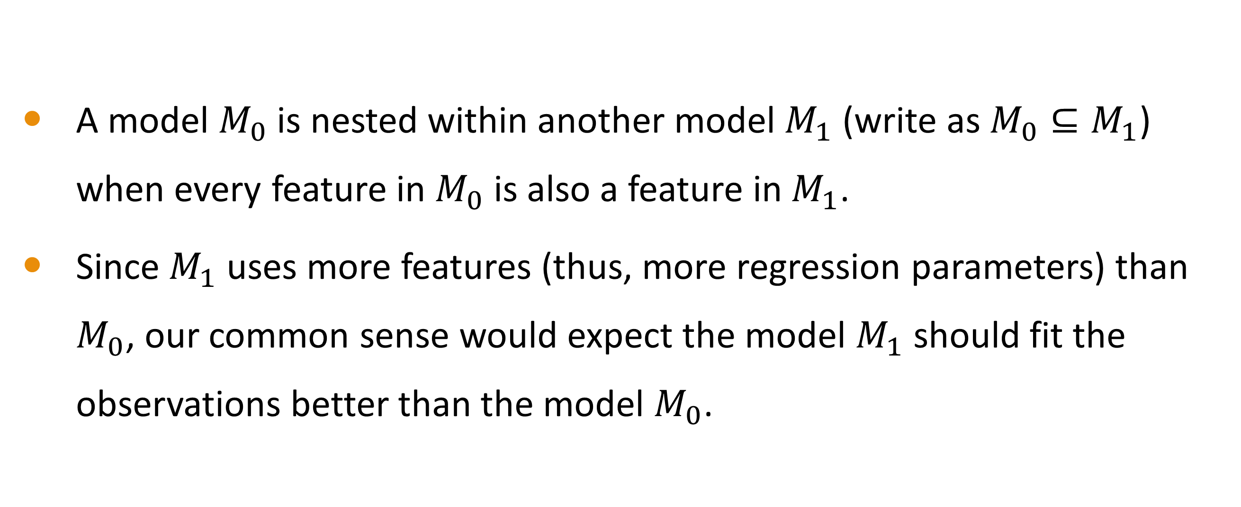
Nested Models
A model $M_{0}$ is nested within another model $M_{1}$ (write as $M_{0}⊆M_{1}$) when every feature in $M_{0}$ is also a feature in $M_{1}$.
Since $M_{1}$ uses more features (thus, more regression parameters) than $M_{0}$, our common sense would expect the model $M_{1}$ should fit the observations better than the model $M_{0}$.

Slide 36
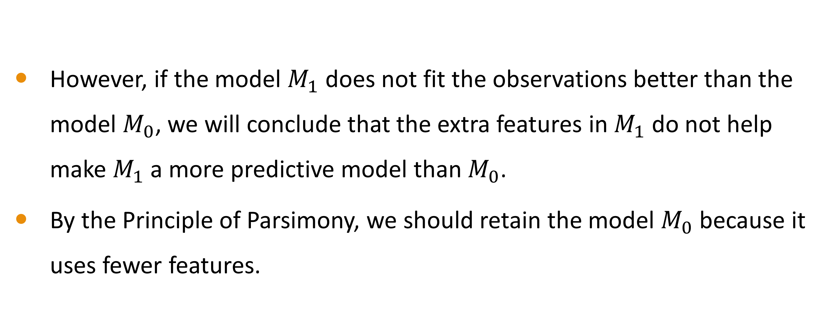
Nested Models
However, if the model $M_{1}$ does not fit the observations better than the model $M_{0}$, we will conclude that the extra features in $M_{1}$ do not help make $M_{1}$ a more predictive model than $M_{0}$.
By the Principle of Parsimony, we should retain the model $M_{0}$ because it uses fewer features.

Slide 37
Deviance Test For Nested Models
Null Hypothesis
Given a pair of nested models $M_{0}⊆M_{1}$
Given a pair of nested models 𝑀_0⊆𝑀_1
Test Statistic
$D=2\left(llk\left(M_{1}\right)−llk\left(M_{0}\right)\right)$ where $llk()$ is the log-likelihood of a model
𝐷=2(𝑙𝑙𝑘(𝑀_1 )−𝑙𝑙𝑘(𝑀_0 )) where 𝑙𝑙𝑘() is the log-likelihood of a model
Test Significance
$D$ follows a Chi-squares distribution with Degree of Freedom DF
𝐷 follows a Chi-squares distribution with Degree of Freedom DF
Significance is upper tail probability of the Chi-squares distribution
The predictors in $M_{1}$ that are not in $M_{0}$ have zero parameter values
The predictors in 𝑀_1 that are not in 𝑀_0 have zero parameter values
Degree of Freedom DF is the number of parameters in $M_{1}$ that are not in $M_{0}$
Degree of Freedom DF is the number of parameters in 𝑀_1 that are not in 𝑀_0

Slide 38
Deviance Test For Nested Model
Is the test significance value less than a pre-specified tolerance threshold (e.g., 0.05)?
We need to retain the additional predictors in $M_{1}$ because they helps improve the goodness-of-fit
We need to retain the additional predictors in 𝑀_1 because they helps improve the goodness-of-fit
We can ignore the additional predictors in $M_{1}$ because dropping them will not hurt the goodness-of-fit
We can ignore the additional predictors in 𝑀_1 because dropping them will not hurt the goodness-of-fit
YES
NO

Slide 39
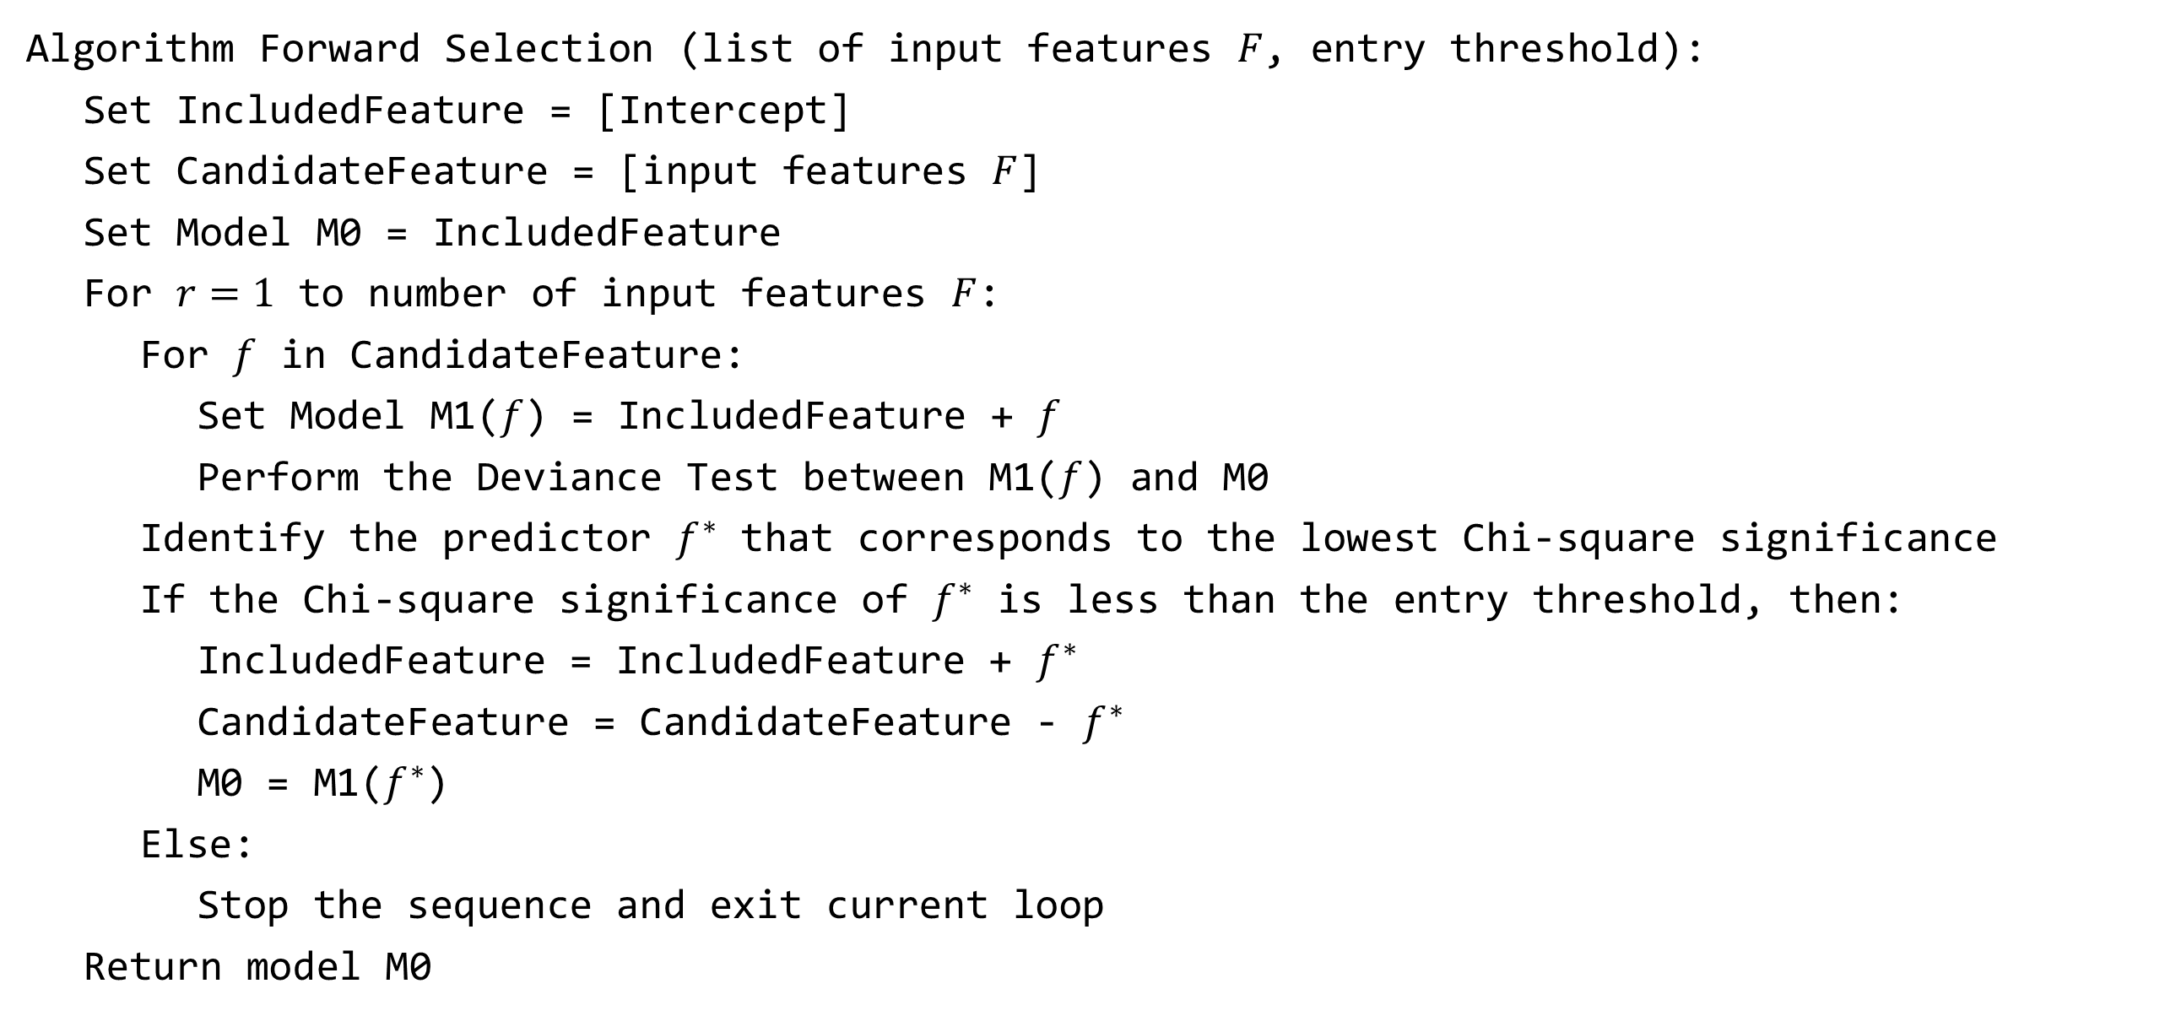
Forward Selection Procedure
Algorithm Forward Selection (list of input features $F$, entry threshold):
Set IncludedFeature = [Intercept]
Set CandidateFeature = [input features $F$]
Set Model M0 = IncludedFeature
For $r=1$ to number of input features $F$:
For $f$ in CandidateFeature:
Set Model M1($f$) = IncludedFeature + $f$
Perform the Deviance Test between M1($f$) and M0
Identify the predictor $f^{∗}$ that corresponds to the lowest Chi-square significance
If the Chi-square significance of $f^{∗}$ is less than the entry threshold, then:
IncludedFeature = IncludedFeature + $f^{∗}$
CandidateFeature = CandidateFeature - $f^{∗}$
M0 = M1($f^{∗}$)
Else:
Stop the sequence and exit current loop
Return model M0

Slide 40
The Pros and Cons of Forward Selection
Pros
It run faster and demands fewer computing resources since it always starts from a model with only the Intercept term.
The final model usually has fewer features.
Cons
The entry threshold for test significance can be debatable.
It searches through a path of increasingly nested models; it may miss other predictive models that are not along the path.

Slide 41
College Student Retention

Slide 42
College Student Retention
Students pursue higher education to achieve academic success.
Dropout is the most problematic issue for higher education institutions.
According to https://educationdata.org/college-dropout-rates:
Between the fall semesters of 2019 and 2020, 24.1% of all first-time, full-time freshmen dropped out of college.
At 4-year institutions, 18.4% of first-time, full-time college freshmen dropped out between 2019 and 2020.
At 2-year institutions, 39.0% of first-time, full-time freshmen dropped out.

Slide 43
College Student Retention
What are the key factors that lead students to drop out?
“Predicting Student Dropout and Academic Success”, Valentim Realinho, Jorge Machado, Luís Baptista and Mónica V. Martins. Data 2022, 7(11), 146. https://doi.org/10.3390/data7110146

Slide 44
College Student Retention
Module 6 Academic Success.py

Slide 45
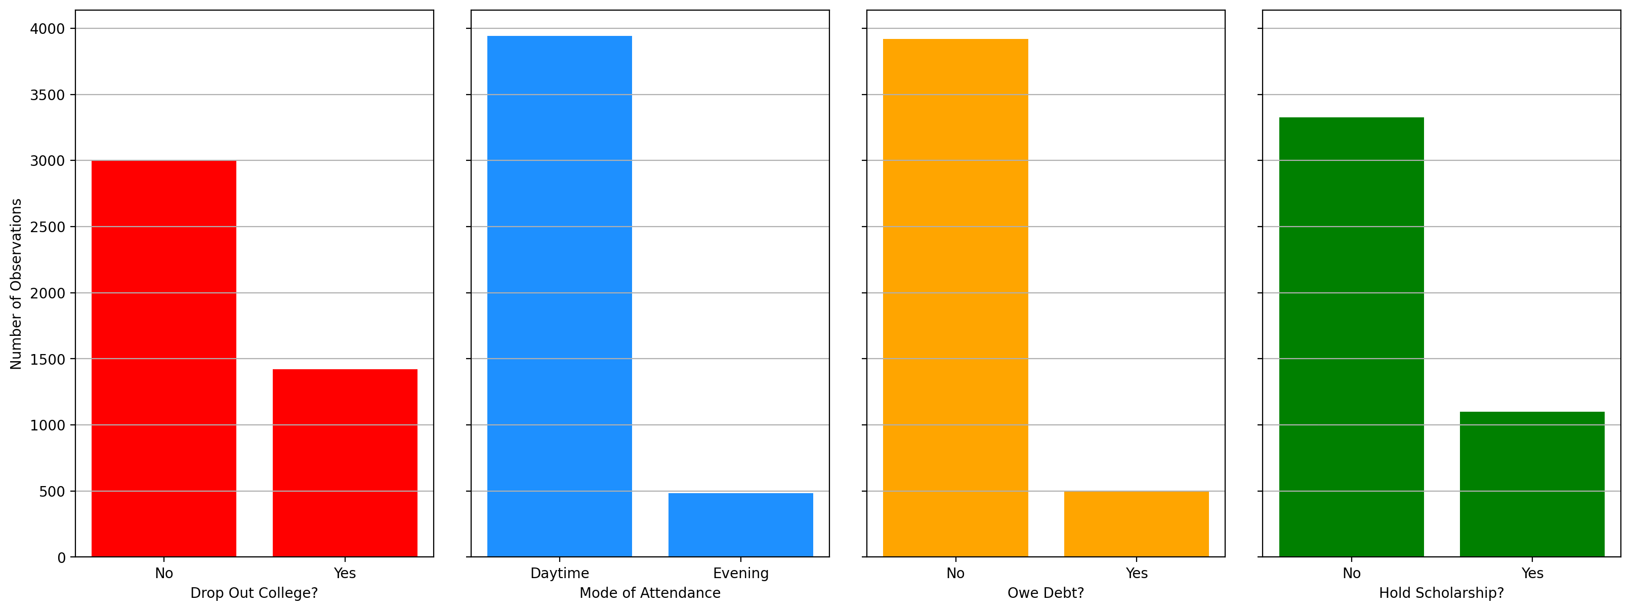
Frequency Bar Charts

Slide 46
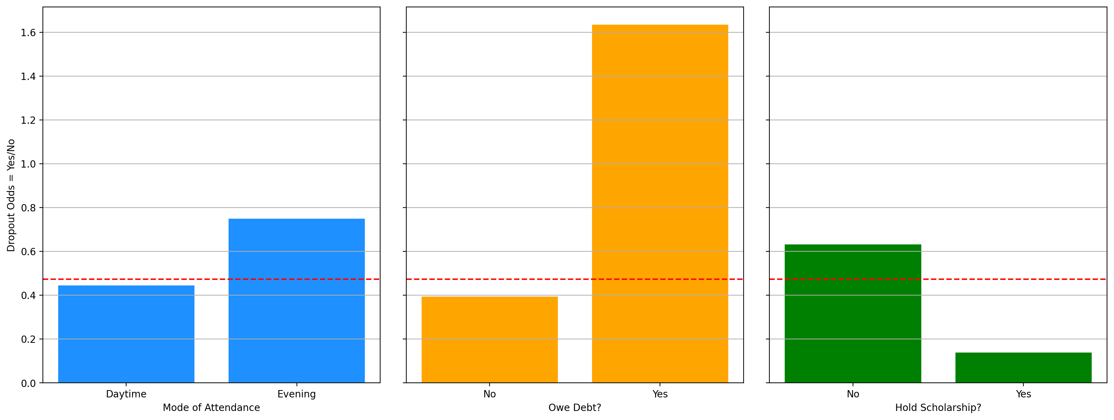
Odds of Dropout Bar Charts
The red dotted line indicates the overall odds of 0.47

Slide 47
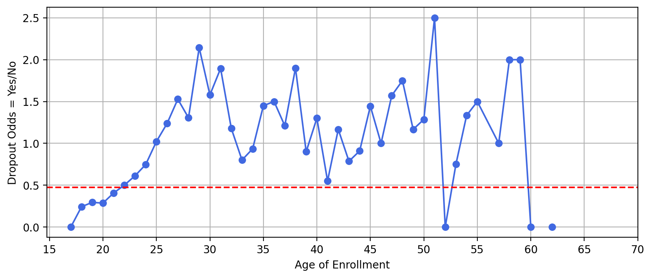
Odds of Dropout Line Charts
Dropout odds increase almost linearly until age 30, then fluctuate wildly afterward.

Slide 48
Forward Selection Specifications
The response is the Dropout Indicator with categories No and Yes.
The categorical features are Attendance, Debtor, and Scholarship holder.
The interval feature is Age at enrollment.
The entry threshold for test significance is 0.05.
All models will include the Intercept term.

Slide 49
Forward Selection Summary
Step | Feature Added | Type | Model | Model |  | Deviance Test
Step | Feature Added | Type | N Iterations | N Parameters | Log-Likelihood | Chi-Square | DF | Significance†
0 | Intercept |  | 4 | 1 | -2,777.2659
1 | Scholarship holder | categorical | 5 | 2 | -2,626.6212 | 301.2893 | 1 | 1.7253E-67
2 | Debtor | categorical | 6 | 3 | -2,529.1858 | 194.8708 | 1 | 2.7493E-44
3 | Age at enrollment | interval | 6 | 4 | -2,446.4034 | 165.5649 | 1 | 6.8851E-38
4 | Attendance | categorical | 6 | 5 | -2,444.2981 | 4.2105 | 1 | 4.0176E-02
†The entry threshold for test significance is 0.05.

Slide 50
END OF LESSON 2

Slide 51
Lesson 3: Interpret Model and Assess Performance

Slide 52
College Student Retention: The Forward Selection Model

Slide 53
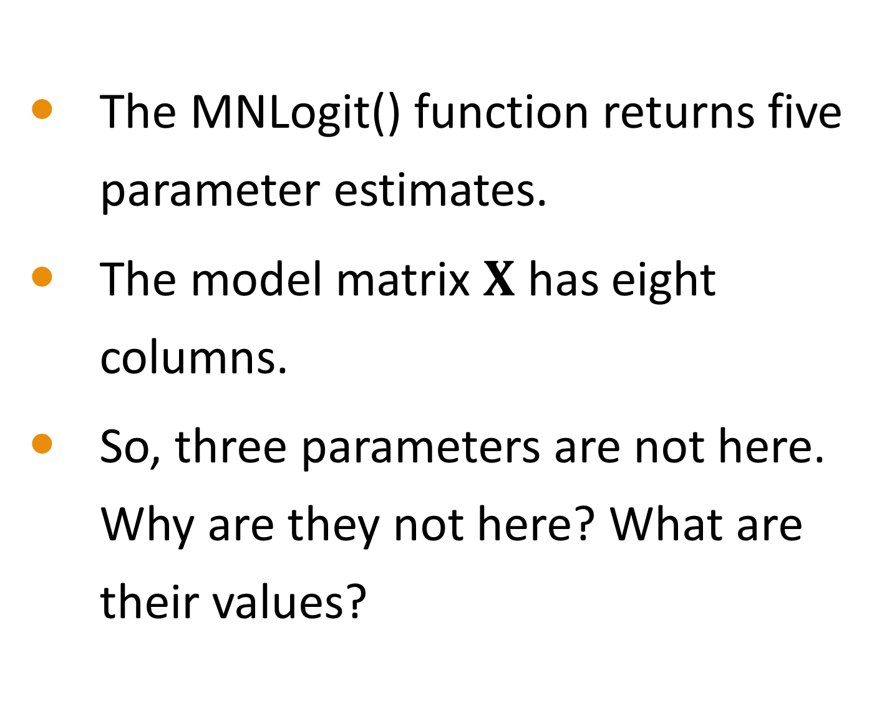
The Forward Selection Model
The MNLogit() function returns five parameter estimates.
The model matrix $X$ has eight columns.
So, three parameters are not here. Why are they not here? What are their values?
Parameter | Estimate
Intercept | -2.3409513
Scholarship holder_No | 1.3392169
Debtor_No | -1.3240921
Age at enrollment | 0.0610271
Attendance_Daytime | 0.2436942

Slide 54
The Aliased Parameters
Three parameters are omitted because they are aliased.
They are Scholarship holder_Yes, Debtor_Yes, and Attendance_Evening.
Since they are aliased, their estimates are assigned the zero values.
In the presence of aliased parameters, the theory tells us that the parameter estimates are not unique. However, the predicted probabilities are not affected, and their values are trustworthy.

Slide 55
The Complete Set of Parameter Estimates
Parameter | Estimate
Intercept | -2.3409513
Scholarship holder_No | 1.3392169
Scholarship holder_Yes† | 0
Debtor_No | -1.3240921
Debtor_Yes† | 0
Age at enrollment | 0.0610271
Attendance_Daytime | 0.2436942
Attendance_Evening† | 0
† Aliased Parameter

Slide 56
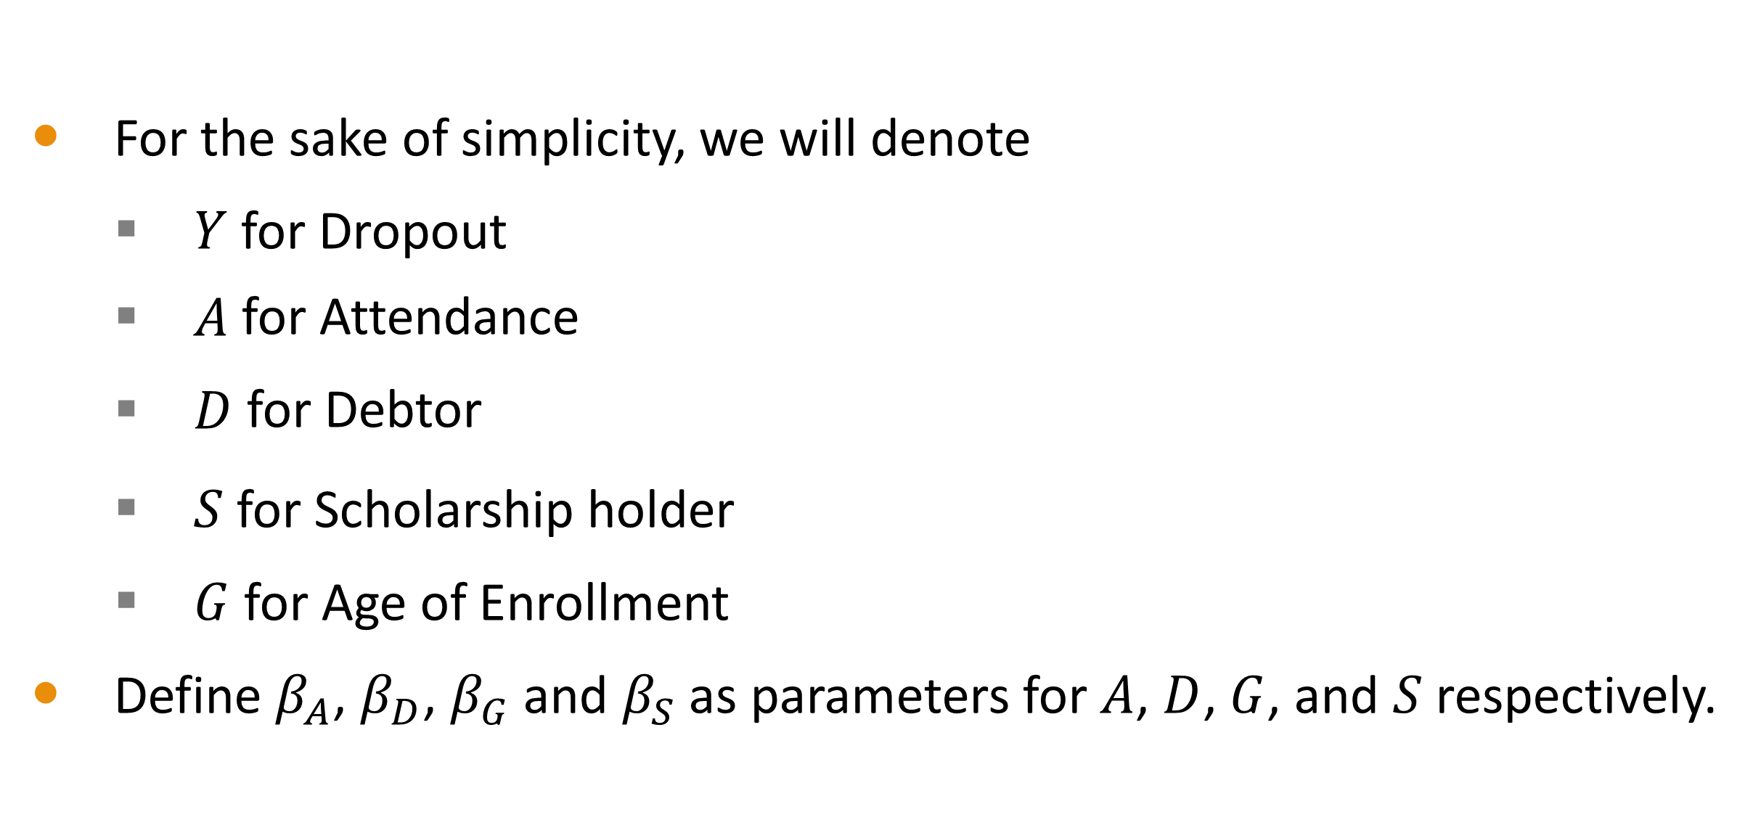
Interpret Parameter Estimates
For the sake of simplicity, we will denote
$Y$ for Dropout
$A$ for Attendance
$D$ for Debtor
$S$ for Scholarship holder
$G$ for Age of Enrollment
Define $β_{A}$, $β_{D}$, $β_{G}$ and $β_{S}$as parameters for $A$, $D$, $G$, and $S$ respectively.

Slide 57
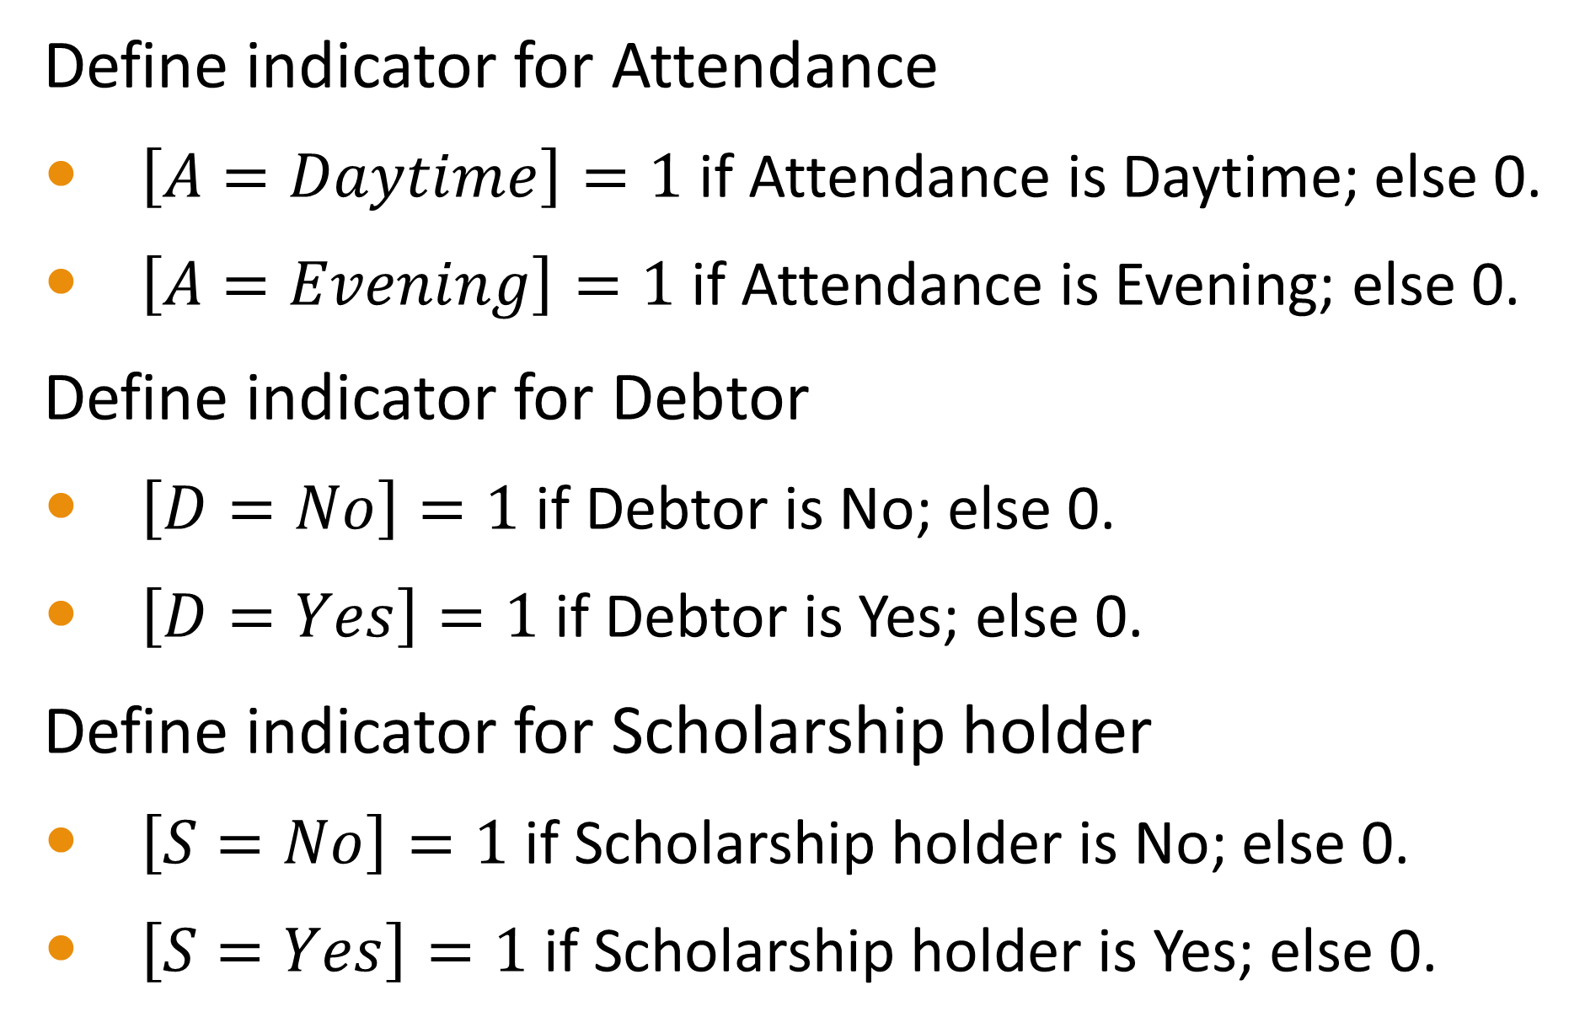
Interpret Parameter Estimates
Define indicator for Attendance
$\left[A=Daytime\right]=1$ if Attendance is Daytime; else 0.
$\left[A=Evening\right]=1$ if Attendance is Evening; else 0.
Define indicator for Debtor
$\left[D=No\right]=1$ if Debtor is No; else 0.
$\left[D=Yes\right]=1$ if Debtor is Yes; else 0.
Define indicator for Scholarship holder
$\left[S=No\right]=1$ if Scholarship holder is No; else 0.
$\left[S=Yes\right]=1$ if Scholarship holder is Yes; else 0.

Slide 58
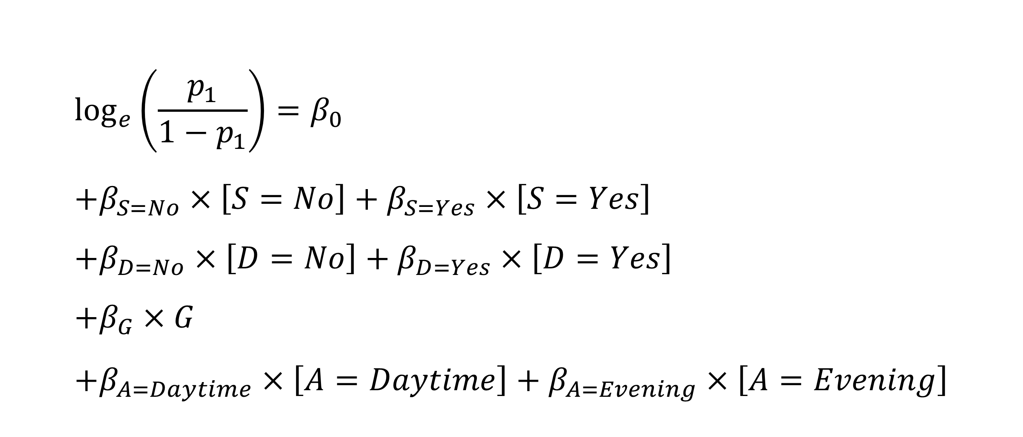
The Logistic Regression Model
$$\log_{e}\left(\frac{p_{1}}{1−p_{1}}\right)=β_{0} \\ +β_{S=No}×\left[S=No\right]+β_{S=Yes}×\left[S=Yes\right] \\ +β_{D=No}×\left[D=No\right]+β_{D=Yes}×\left[D=Yes\right] \\ +β_{G}×G \\ +β_{A=Daytime}×\left[A=Daytime\right]+β_{A=Evening}×\left[A=Evening\right]$$

Slide 59
Two Attendance Scenarios
Scenario I
Scenario II
Attendance is Evening
$p_{1}^{II}$ is the probability of dropping out
𝑝_1^𝐼𝐼 is the probability of dropping out
Debtor is No and Scholarship holder is Yes
Age of Enrollment is 18
$p_{1}^{I}$ is the probability of dropping out
𝑝_1^𝐼 is the probability of dropping out
Attendance is Daytime
Debtor is No and Scholarship holder is Yes
Age of Enrollment is 18

Slide 60
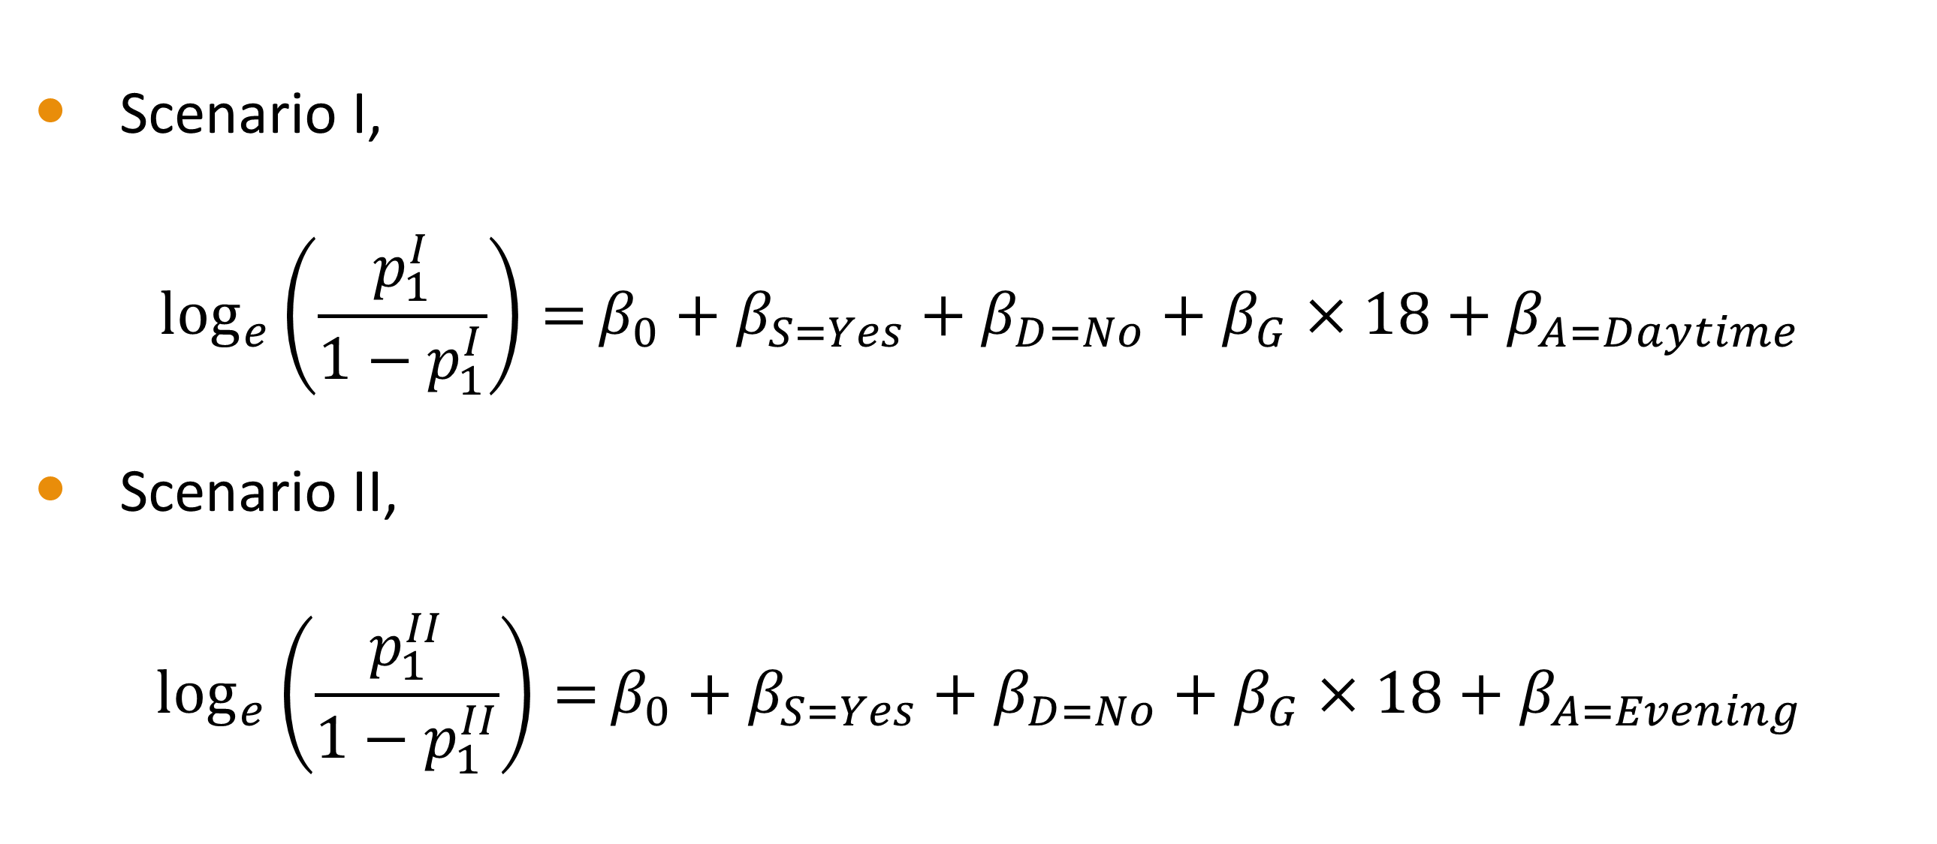
Two Attendance Scenarios
Scenario I,
$$\log_{e}\left(\frac{p_{1}^{I}}{1−p_{1}^{I}}\right)=β_{0}+β_{S=Yes}+β_{D=No}+β_{G}×18+β_{A=Daytime}$$
Scenario II,
$$\log_{e}\left(\frac{p_{1}^{II}}{1−p_{1}^{II}}\right)=β_{0}+β_{S=Yes}+β_{D=No}+β_{G}×18+β_{A=Evening}$$

Slide 61
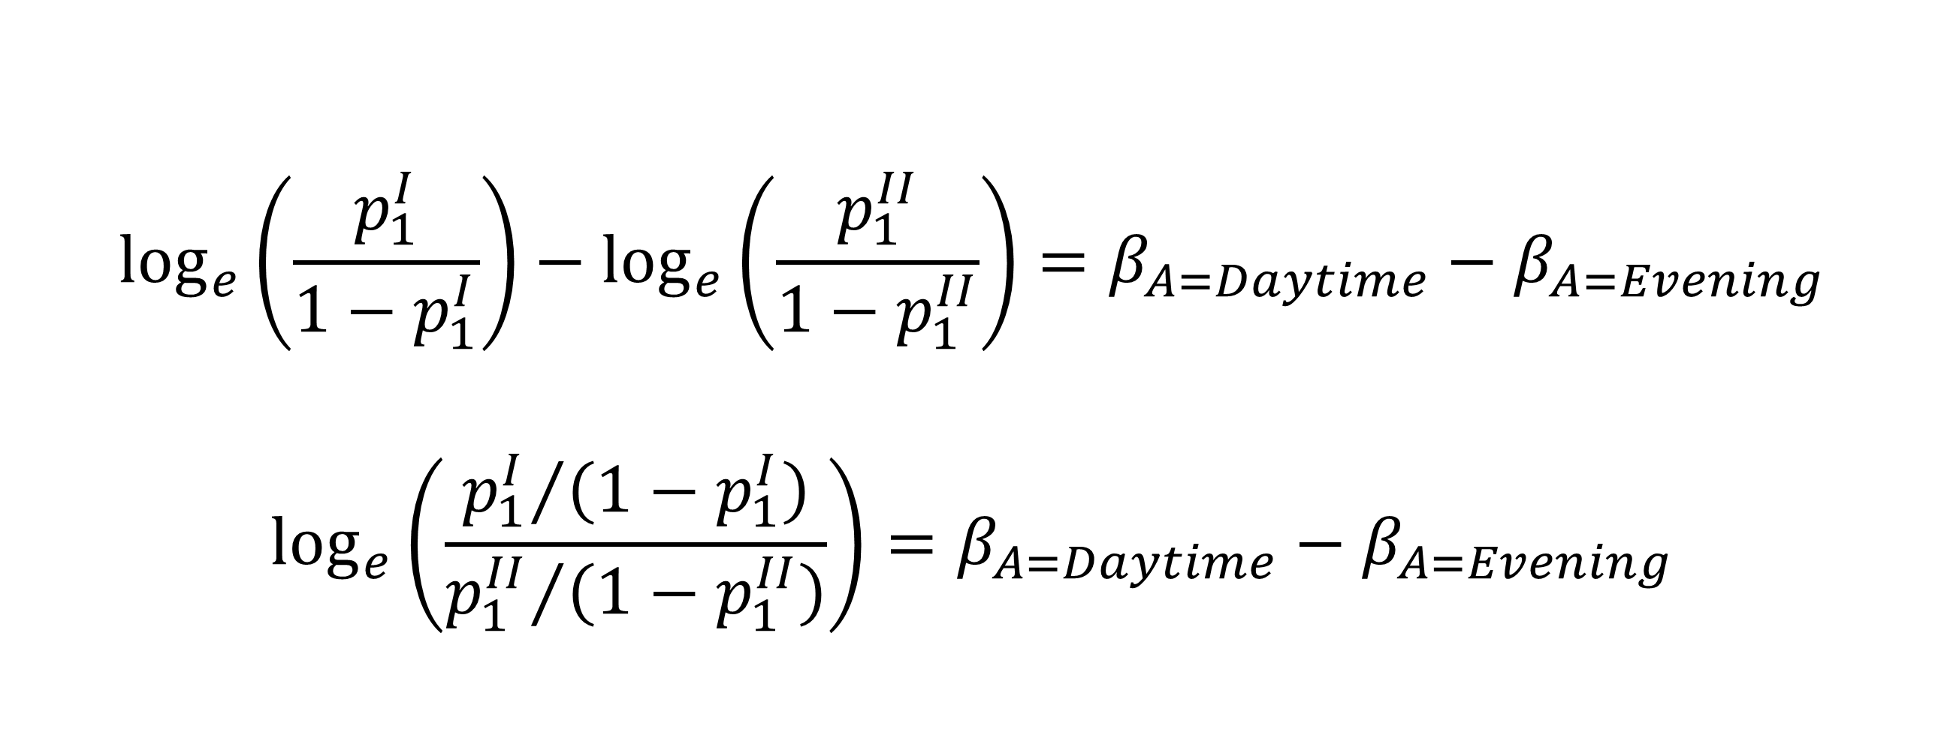
Two Attendance Scenarios
$$\log_{e}\left(\frac{p_{1}^{I}}{1−p_{1}^{I}}\right)−\log_{e}\left(\frac{p_{1}^{II}}{1−p_{1}^{II}}\right)=β_{A=Daytime}−β_{A=Evening}$$
$$\log_{e}\left(\frac{{p_{1}^{I}}/{\left(1−p_{1}^{I}\right)}}{{p_{1}^{II}}/{\left(1−p_{1}^{II}\right)}}\right)=β_{A=Daytime}−β_{A=Evening}$$

Slide 62
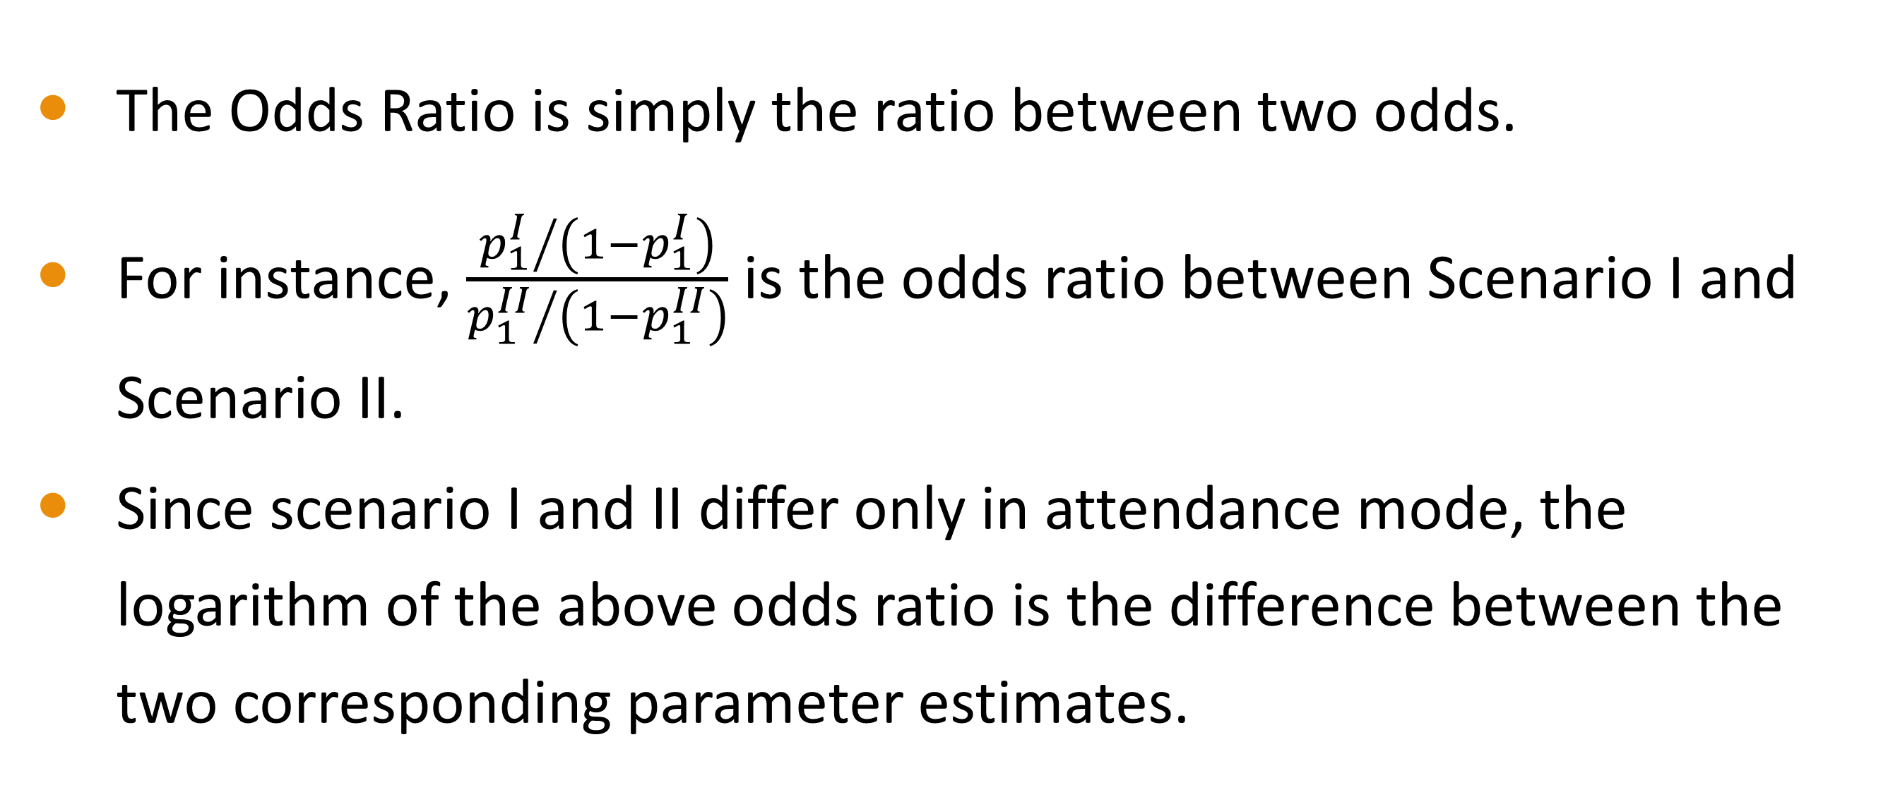
Odds Ratio
The Odds Ratio is simply the ratio between two odds.
For instance, $\frac{{p_{1}^{I}}/{\left(1−p_{1}^{I}\right)}}{{p_{1}^{II}}/{\left(1−p_{1}^{II}\right)}}$ is the odds ratio between Scenario I and Scenario II.
Since scenario I and II differ only in attendance mode, the logarithm of the above odds ratio is the difference between the two corresponding parameter estimates.

Slide 63
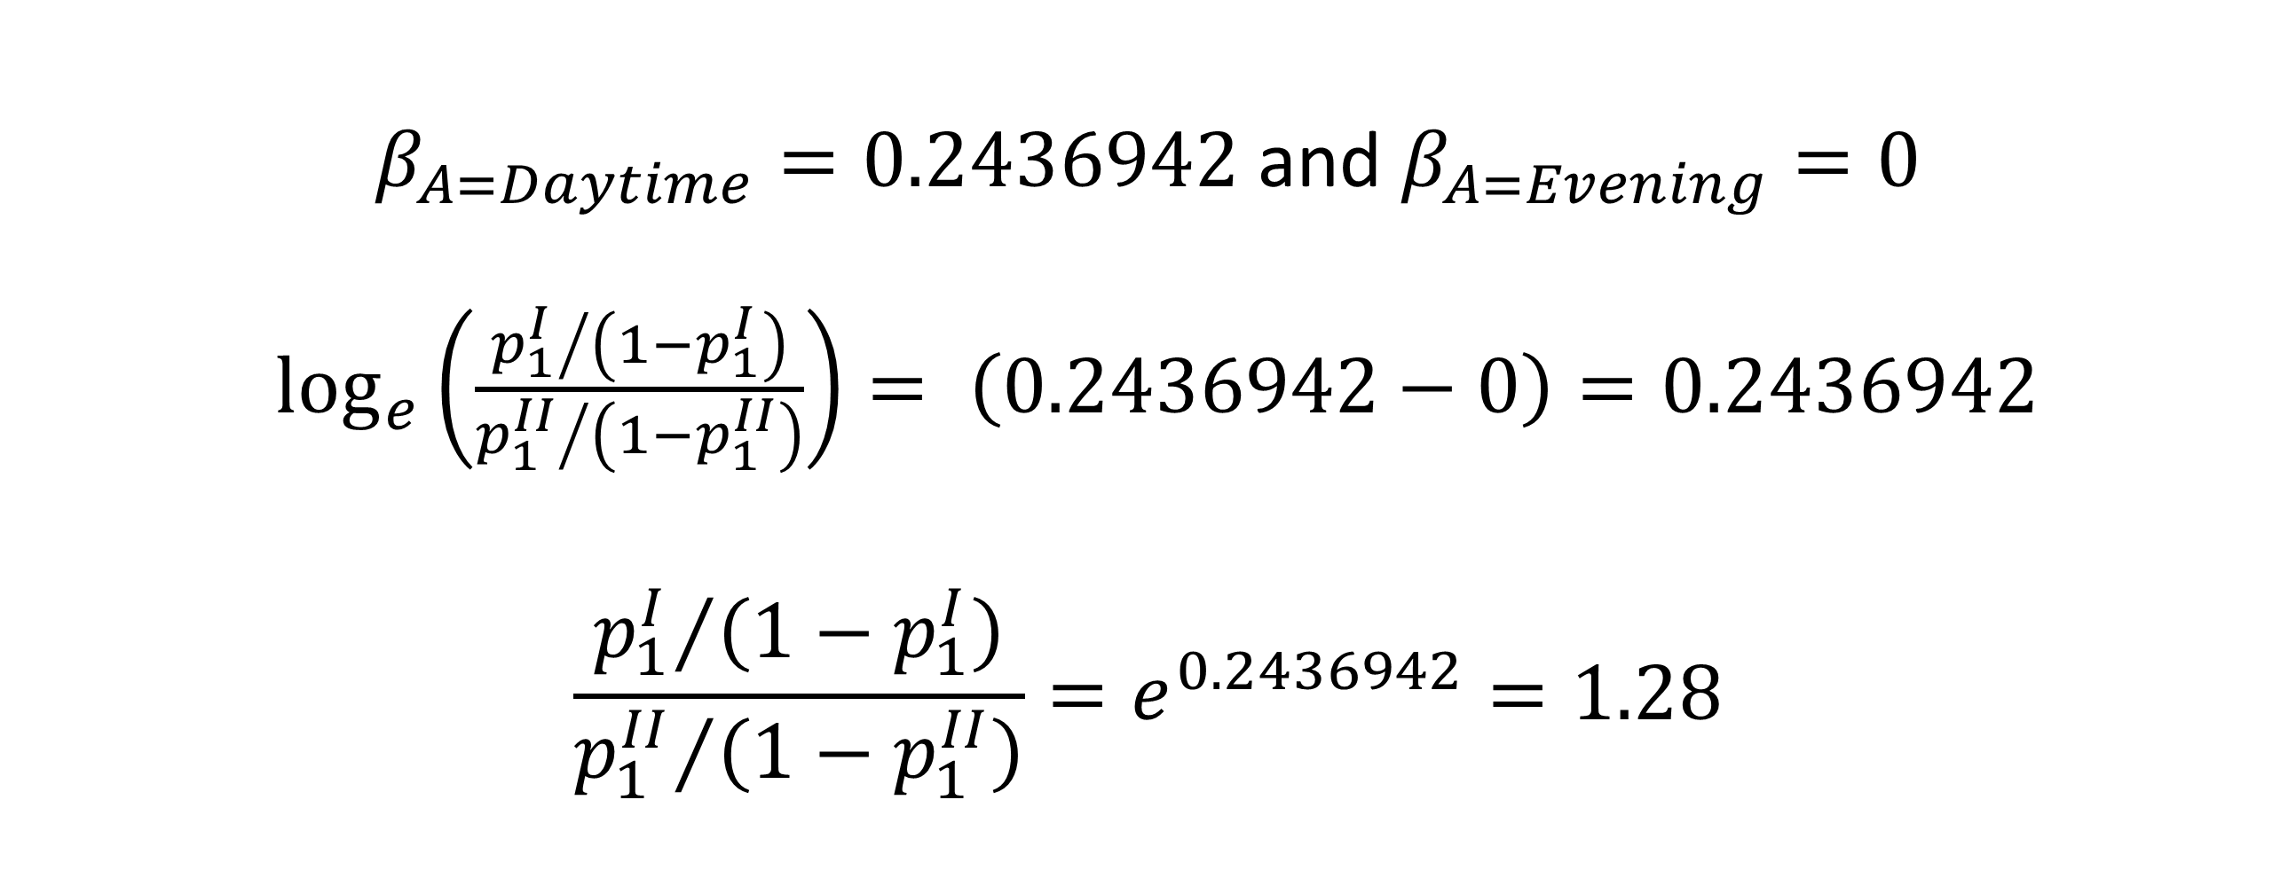
Two Attendance Scenarios
$β_{A=Daytime}=0.2436942$ and $β_{A=Evening}=0$
$\log_{e}\left(\frac{{p_{1}^{I}}/{\left(1−p_{1}^{I}\right)}}{{p_{1}^{II}}/{\left(1−p_{1}^{II}\right)}}\right)= \left(0.2436942−0\right)=0.2436942$
$$\frac{{p_{1}^{I}}/{\left(1−p_{1}^{I}\right)}}{{p_{1}^{II}}/{\left(1−p_{1}^{II}\right)}}=e^{0.2436942}=1.28$$

Slide 64
Two Attendance Scenarios
The odds ratio between Scenario I and Scenario II is 1.28.
Let us consider an 18-years old college student with a scholarship but no debts. If the student attends Daytime classes instead of Evening classes, the student will raise his/her odds of dropping out by a factor of 1.28.
An academic advisor should suggest this student to take Evening classes.

Slide 65
Two Age of Enrollment Scenarios
Scenario I
Scenario II
Attendance is Daytime
$p_{1}^{II}$ is the probability of dropping out
𝑝_1^𝐼𝐼 is the probability of dropping out
Debtor is No and Scholarship holder is Yes
Age of Enrollment is 25
$p_{1}^{I}$ is the probability of dropping out
𝑝_1^𝐼 is the probability of dropping out
Attendance is Daytime
Debtor is No and Scholarship holder is Yes
Age of Enrollment is 18

Slide 66

Two Age of Enrollment Scenarios
Scenario I,
$$\log_{e}\left(\frac{p_{1}^{I}}{1−p_{1}^{I}}\right)=β_{0}+β_{S=Yes}+β_{D=No}+β_{G}×18+β_{A=Daytime}$$
Scenario II,
$$\log_{e}\left(\frac{p_{1}^{II}}{1−p_{1}^{II}}\right)=β_{0}+β_{S=Yes}+β_{D=No}+β_{G}×25+β_{A=Daytime}$$

Slide 67
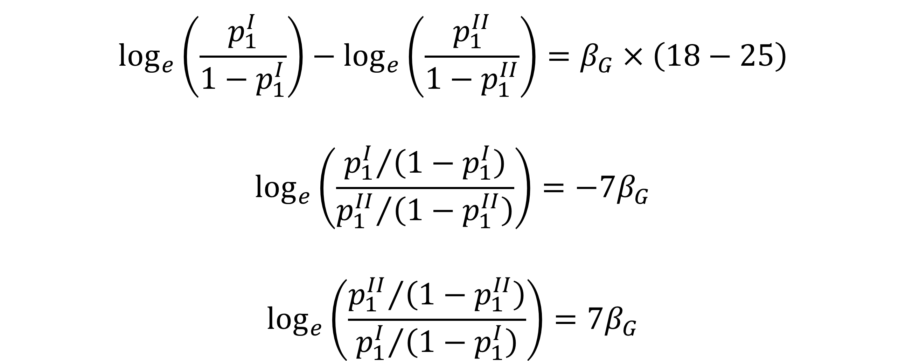
Two Age of Enrollment Scenarios
$$\log_{e}\left(\frac{p_{1}^{I}}{1−p_{1}^{I}}\right)−\log_{e}\left(\frac{p_{1}^{II}}{1−p_{1}^{II}}\right)=β_{G}×\left(18−25\right)$$
$$\log_{e}\left(\frac{{p_{1}^{I}}/{\left(1−p_{1}^{I}\right)}}{{p_{1}^{II}}/{\left(1−p_{1}^{II}\right)}}\right)=−7β_{G}$$
$$\log_{e}\left(\frac{{p_{1}^{II}}/{\left(1−p_{1}^{II}\right)}}{{p_{1}^{I}}/{\left(1−p_{1}^{I}\right)}}\right)=7β_{G}$$

Slide 68
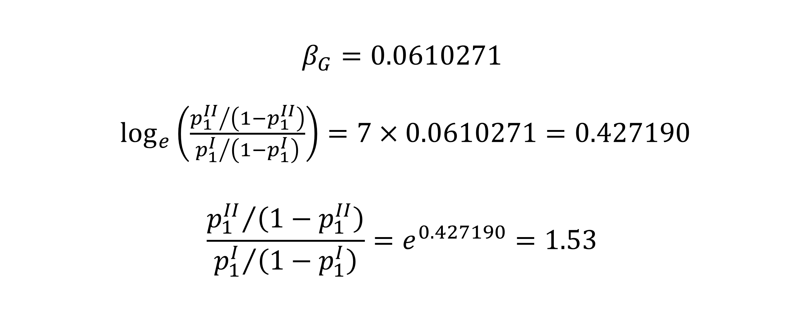
Two Age of Enrollment Scenarios
$$β_{G}=0.0610271$$
$\log_{e}\left(\frac{{p_{1}^{II}}/{\left(1−p_{1}^{II}\right)}}{{p_{1}^{I}}/{\left(1−p_{1}^{I}\right)}}\right)=7×0.0610271=0.427190$
$$\frac{{p_{1}^{II}}/{\left(1−p_{1}^{II}\right)}}{{p_{1}^{I}}/{\left(1−p_{1}^{I}\right)}}=e^{0.427190}=1.53$$

Slide 69
Two Age of Enrollment Scenarios
The odds ratio between Scenario II and Scenario I is 1.53.
Let us consider a college student with a scholarship but no debts. Also, the student attends Daytime classes. If the student defers enrollment for seven years, the student will raise his/her odds of dropping out by a factor of 1.53.
An academic advisor should suggest this student to NOT defer enrollment for seven years.

Slide 70
College Student Retention: Assess Model

Slide 71
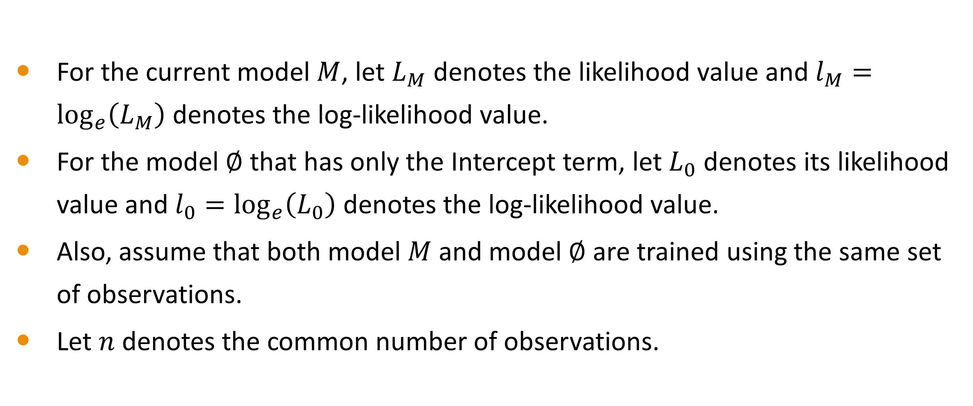
Measure of Association
For the current model $M$, let $L_{M}$ denotes the likelihood value and $l_{M}=\log_{e}\left(L_{M}\right)$ denotes the log-likelihood value.
For the model $∅$ that has only the Intercept term, let $L_{0}$ denotes its likelihood value and $l_{0}=\log_{e}\left(L_{0}\right)$ denotes the log-likelihood value.
Also, assume that both model $M$ and model $∅$ are trained using the same set of observations.
Let $n$ denotes the common number of observations.

Slide 72
Measure of Association
McFadden
$$R_{MF}^{2}=1−\left({l_{M}}/{l_{0}}\right)$$
𝑅_𝑀𝐹^2=1−(𝑙_𝑀∕𝑙_0 )
$${0≤R}_{MF}^{2}≤1$$
〖0≤𝑅〗_𝑀𝐹^2≤1
Cox & Snell
$$R_{CS}^{2}=1−{\left({L_{0}}/{L_{M}}\right)}^{2/n}$$
𝑅_𝐶𝑆^2=1−(𝐿_0∕𝐿_𝑀 )^(2∕𝑛)
$${0≤R}_{CS}^{2}≤\left(1−L_{0}^{2/n}\right)$$
〖0≤𝑅〗_𝐶𝑆^2≤(1−𝐿_0^(2∕𝑛) )
Nagelkerke
$$R_{N}^{2}={R_{CS}^{2}}/{\left(1−L_{0}^{2/n}\right)}$$
𝑅_𝑁^2=𝑅_𝐶𝑆^2∕(1−𝐿_0^(2∕𝑛) )
$${0≤R}_{N}^{2}≤1$$
〖0≤𝑅〗_𝑁^2≤1

Slide 73
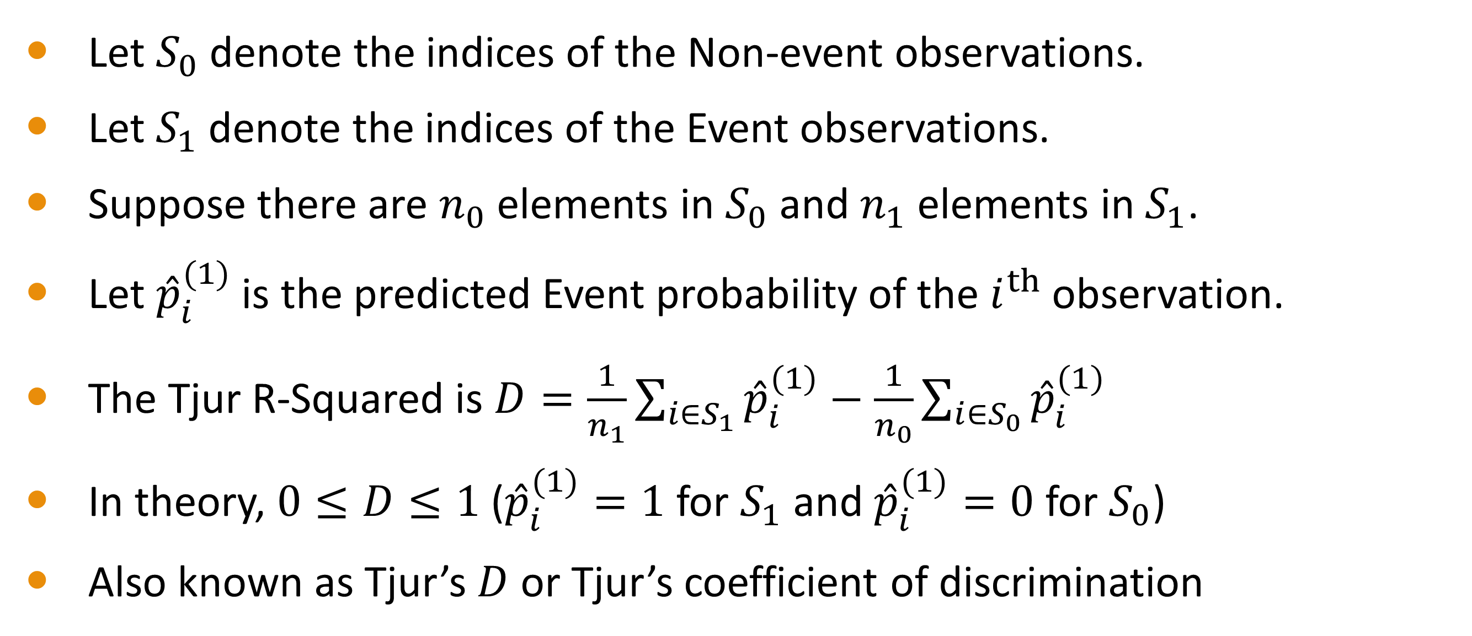
Tjur R-Squared
Let $S_{0}$ denote the indices of the Non-event observations.
Let $S_{1}$ denote the indices of the Event observations.
Suppose there are $n_{0}$ elements in $S_{0}$ and $n_{1}$ elements in $S_{1}$.
Let ${\hat{p}}_{i}^{(1)}$ is the predicted Event probability of the $i^{th}$ observation.
The Tjur R-Squared is $D=\frac{1}{n_{1}}\sum_{i∈S_{1}}{{\hat{p}}_{i}^{(1)}}−\frac{1}{n_{0}}\sum_{i∈S_{0}}{{\hat{p}}_{i}^{(1)}}$
In theory, $0≤D≤1$ (${\hat{p}}_{i}^{(1)}=1$ for $S_{1}$ and ${\hat{p}}_{i}^{(1)}=0$ for $S_{0}$)
Also known as Tjur’s $D$ or Tjur’s coefficient of discrimination

Slide 74
Measure of Association
Daniel McFadden (1974) “Conditional logit analysis of qualitative choice behavior.” Pages 105-142 in P. Zarembka (ed.), Frontiers in Econometrics. Academic Press.
David R. Cox and E. Joyce Snell (1989) Analysis of Binary Data. Second Edition. Chapman & Hall.
Nicolaas Jan Dirk Nagelkerke (1991) “A note on a general definition of the coefficient of determination.” Biometrika, volume 78, pages 691-692.
Tue Tjur (2009) “Coefficients of determination in logistic regression models — A new proposal: The coefficient of discrimination.” The American Statistician, volume 63, pages 366-372.

Slide 75
College Student Retention Model
Measure of Association | Value
McFadden | 0.1199
Cox and Snell | 0.1397
Nagelkerke | 0.1954
Tjur | 0.1452
All the measures suggest that the current model is a good starter. However, there are plenty of room for improvement.

Slide 76
END OF LESSON 3

Slide 77
END OF MODULE 6

